Slide 1
Agenda
Opening Remarks
Introductions/Review of Agenda
ROTC
National Guard
US Army Reserve
AMEDD

Slide 2
ARMY ROTC
The best leadership Course in America
1 of 2 Ways to Earn an Army Commission while pursuing a 4 YR Bachelor’s Degree

Slide 3
ARMY ROTC
Largest Producer of US Army Officers
Produces Officers for Active & Reserve Service
Offered at over 273 Colleges/Universities
Does Not Require a Senatorial/Congressional Nomination

Slide 4
Army ROTC Training Opportunities
SIMULTANEOUS MEMBERSHIP PROGRAM (SMP)
BASIC CAMP-FORT KNOX, KENTUCKY
AIRBORNE
AIR ASSAULT
MOUTAIN WARFARE
CADET TROOP LEADERSHIP TRAINING (CTLT)
INTERNSHIPS
ADVANCED CAMP-FORT KNOX, KENTUCKY

Slide 5
PATHS TO A COMMISSION THROUGH ROTC
PROGRESSION CANDIDATE
LATERAL ENTRY CANDIDATE
TAKES ALL FOUR YEARS OF THE ROTC CURRICULUM ON A COLLEGE CAMPUS AND ATTENDS ADVANCED CAMP BETWEEN THE SUMMER OF THEIR JUNIOR-SENIOR YEAR
ENCOURAGED TO ATTEND AIRBORNE OR AIR ASSAULT, INTERNSHIPS,CTLT
ATTENDS ROTC BASIC CAMP BETWEEN THE SUMMER OF SOPHOMORE/JUNIOR YEAR USUALLY HAS NOT PARTICIPATED IN THE ROTC CURRICULUM ON CAMPUS
OR
ATTENDS BASIC TRAINING WITH A NATIONAL GUARD/ARMY RESERVE UNIT AND PETITIONS TO ENTER THE ROTC ADVANCED COURSE

Slide 6
PATHS TO A COMMISSION THROUGH ROTC
ACCELRATED CANDIDATE
ALTERNATE ENTRY OPTION-(AEO)
STUDENT TAKES BOTH THE MLS 100 AND 200 LEVEL CLASSES AND THE 200 LEVEL LAB AND PETITIONS TO ENTER THE ROTC ADVANCED COURSE
ATTENDS ADVANCED CAMP BETWEEN THE SUMMER OF THEIR JUNIOR-SENIOR YEAR
ENCOURAGED TO ATTEND CTLT, AIRBORNE/AIR ASSAULT/INTERNSHIPS
STUDENT SUBMITS SUPPORTING DOCUMENTATION AND RECEIVES A WAIVER TO BEGIN THE ROTC ADVANCED COURSE DURING THEIR JUNIOR YEAR
STUDENT ATTENDS BASIC CAMP AFTER THEIR JUNIOR YEAR
STUDENT ATTENDS ADVANCED CAMP AFTER THEIR DEGREE IS CONFERRED AND ARE COMMISSIONED AFTER COMPLETION OF ROTC ADVANCED CAMP

Slide 7
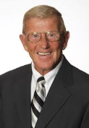
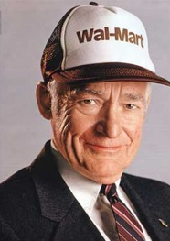
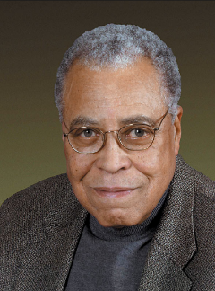
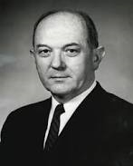
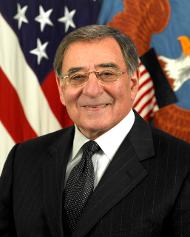
Notable ROTC Graduates
Lou Holtz (Kent State)
Sam Walton (University of Missouri)
Earl Graves (Morgan State University)
James Earl Jones (University of Michigan)
Samuel Alito (Princeton)
Frank Wells (Pomona College)
Dean Rusk (Davidson College)
Nancy Currie (Ohio State)
Leon Panetta (Santa Clara University)
Darrell Issa (Kent State)
Douglas Clayton (Cornell University)
Lou Holtz
Former American football player, coach, and analyst. Elected College Football Hall of Fame
Sam Walton
American businessman and entrepreneur best known for founding the retailers Walmart and Sam's Club
James Earl Jones
American actor. His career has spanned more than 60 years, and he has been described as "one of America's most distinguished and versatile" actors and "one of the greatest actors in American history
Dean Rusk
United States Secretary of State from 1961 to 1969 under presidents John F. Kennedy and Lyndon B. Johnson
Leon Panetta
American statesman, lawyer, and professor. He served in the Obama administration as Director of the Central Intelligence Agency from 2009 to 2011, and as Secretary of Defense from 2011 to 2013

Slide 8
HIGH SCHOOL Scholarship Opportunities
4 YR
3 YR ADVANCED DESIGNEE

Slide 9
SCHOLARSHIP APPLICATION
www.goarmy.com/rotc
APPLICATION OPENS 12 JUNE OF JUNIOR YEAR
DEADLINE TO INITIATE APPLICATION – 04 FEB OF STUDENT’S SENIOR YEAR

Slide 10
BOARD READY
Submit high school transcripts (9th-11th grade)
Send SAT/ACT scores to Cadet Command
Complete Physical Fitness Assessment (PFA)
Complete Interview with a Professor of Military Science (PMS)

Slide 11
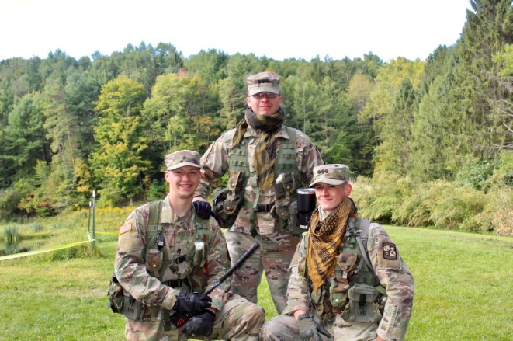
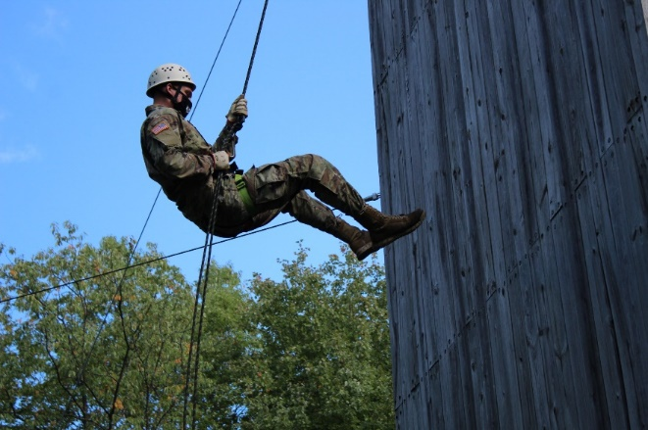
National Army ROTC Scholarship Criteria
(to be competitive)
SCHOLAR
GPA: 3.0+
SAT/ACT: 1100+/23+
National Honor Society, Honors or AP classes
ATHLETE
Varsity or Junior Varsity Sports
Be physically fit
Active in regional sports, intramurals, martial arts, etc
LEADER
Student government (student council, class officer)
School club leader
Boy Scouts (Eagle Scout) / Girl Scouts (Gold Award)
Community Service Volunteer Leaders
American Legion Boys/Girls State selectee
*Initiate a scholarship application: https://hs.usarmy.com/

Slide 12
CAMPUS Based Army ROTC Scholarship Process
CAMPUS BASED PACKET
STUDENT’S ACADEMIC WORK PLAN (104R)
COLLEGE TRANSCRIPTS –SECOND SEMESTER FRESHMAN
HIGH SCHOOL TRANSCRIPTS AND SAT/ACT SCORE-FIRST SEMESTER FRESHMAN
RESUME’
PERSONAL ESSAY
ARMY COMBAT FITNESS TEST (ACFT)
COMPLETE A BOARD INTERVIEW
*Initiate a scholarship application: with the ROTC Department on Campus

Slide 13
Scholarships
Cover Either “Full Tuition & Fees” or “Room & Board capped at $5000 a semester”
Includes a book stipend of $600 per semester
Includes a Cadet stipend - $420 per month during the academic semesters

Slide 14
Service Obligation
Overall 8 years:
4 Years Active Duty & 4 Years either staying on Active Duty; serving in the Inactive Ready Reserve (IRR); or Army Reserve; or Army National Guard
OR
8 Years serving as a drilling Reserve Component Officer in either the Army Reserve or Army National Guard

Slide 15
Contact Information
Lieutenant Colonel Chad Gosney
Professor of Military Science @ Canisius College
Office: 716-888-3235
Email: gosneyc@canisius.edu
Rebecca Sparacino, Lieutenant Colonel (Retired)
ROTC Recruiting Operations Officer @ Canisius College
Office: (716)-888-3239
Email: sparacir@canisius.edu

Slide 16
Agenda
Opening Remarks
Introductions/Review of Agenda
ROTC
National Guard
US Army Reserve
AMEDD

Slide 17
ARMY ROTC
The best leadership Course in America
1 of 2 Ways to Earn an Army Commission while pursuing a 4 YR Bachelor’s Degree

Slide 18
ARMY ROTC
Largest Producer of US Army Officers
Produces Officers for Active & Reserve Service
Offered at over 273 Colleges/Universities
Does Not Require a Senatorial/Congressional Nomination

Slide 19
Army ROTC Training Opportunities
SIMULTANEOUS MEMBERSHIP PROGRAM (SMP)
BASIC CAMP-FORT KNOX, KENTUCKY
AIRBORNE
AIR ASSAULT
MOUTAIN WARFARE
CADET TROOP LEADERSHIP TRAINING (CTLT)
INTERNSHIPS
ADVANCED CAMP-FORT KNOX, KENTUCKY

Slide 20
PATHS TO A COMMISSION THROUGH ROTC
PROGRESSION CANDIDATE
LATERAL ENTRY CANDIDATE
TAKES ALL FOUR YEARS OF THE ROTC CURRICULUM ON A COLLEGE CAMPUS AND ATTENDS ADVANCED CAMP BETWEEN THE SUMMER OF THEIR JUNIOR-SENIOR YEAR
ENCOURAGED TO ATTEND AIRBORNE OR AIR ASSAULT, INTERNSHIPS,CTLT
ATTENDS ROTC BASIC CAMP BETWEEN THE SUMMER OF SOPHOMORE/JUNIOR YEAR USUALLY HAS NOT PARTICIPATED IN THE ROTC CURRICULUM ON CAMPUS
OR
ATTENDS BASIC TRAINING WITH A NATIONAL GUARD/ARMY RESERVE UNIT AND PETITIONS TO ENTER THE ROTC ADVANCED COURSE

Slide 21
PATHS TO A COMMISSION THROUGH ROTC
ACCELRATED CANDIDATE
ALTERNATE ENTRY OPTION-(AEO)
STUDENT TAKES BOTH THE MLS 100 AND 200 LEVEL CLASSES AND THE 200 LEVEL LAB AND PETITIONS TO ENTER THE ROTC ADVANCED COURSE
ATTENDS ADVANCED CAMP BETWEEN THE SUMMER OF THEIR JUNIOR-SENIOR YEAR
ENCOURAGED TO ATTEND CTLT, AIRBORNE/AIR ASSAULT/INTERNSHIPS
STUDENT SUBMITS SUPPORTING DOCUMENTATION AND RECEIVES A WAIVER TO BEGIN THE ROTC ADVANCED COURSE DURING THEIR JUNIOR YEAR
STUDENT ATTENDS BASIC CAMP AFTER THEIR JUNIOR YEAR
STUDENT ATTENDS ADVANCED CAMP AFTER THEIR DEGREE IS CONFERRED AND ARE COMMISSIONED AFTER COMPLETION OF ROTC ADVANCED CAMP

Slide 22
Notable ROTC Graduates
Lou Holtz (Kent State)
Sam Walton (University of Missouri)
Earl Graves (Morgan State University)
James Earl Jones (University of Michigan)
Samuel Alito (Princeton)
Frank Wells (Pomona College)
Dean Rusk (Davidson College)
Nancy Currie (Ohio State)
Leon Panetta (Santa Clara University)
Darrell Issa (Kent State)
Douglas Clayton (Cornell University)
Lou Holtz
Former American football player, coach, and analyst. Elected College Football Hall of Fame
Sam Walton
American businessman and entrepreneur best known for founding the retailers Walmart and Sam's Club
James Earl Jones
American actor. His career has spanned more than 60 years, and he has been described as "one of America's most distinguished and versatile" actors and "one of the greatest actors in American history
Dean Rusk
United States Secretary of State from 1961 to 1969 under presidents John F. Kennedy and Lyndon B. Johnson
Leon Panetta
American statesman, lawyer, and professor. He served in the Obama administration as Director of the Central Intelligence Agency from 2009 to 2011, and as Secretary of Defense from 2011 to 2013

Slide 23
HIGH SCHOOL Scholarship Opportunities
4 YR
3 YR ADVANCED DESIGNEE

Slide 24
SCHOLARSHIP APPLICATION
www.goarmy.com/rotc
APPLICATION OPENS 12 JUNE OF JUNIOR YEAR
DEADLINE TO INITIATE APPLICATION – 04 FEB OF STUDENT’S SENIOR YEAR

Slide 25
BOARD READY
Submit high school transcripts (9th-11th grade)
Send SAT/ACT scores to Cadet Command
Complete Physical Fitness Assessment (PFA)
Complete Interview with a Professor of Military Science (PMS)

Slide 26
National Army ROTC Scholarship Criteria
(to be competitive)
SCHOLAR
GPA: 3.0+
SAT/ACT: 1100+/23+
National Honor Society, Honors or AP classes
ATHLETE
Varsity or Junior Varsity Sports
Be physically fit
Active in regional sports, intramurals, martial arts, etc
LEADER
Student government (student council, class officer)
School club leader
Boy Scouts (Eagle Scout) / Girl Scouts (Gold Award)
Community Service Volunteer Leaders
American Legion Boys/Girls State selectee
*Initiate a scholarship application: https://hs.usarmy.com/

Slide 27
CAMPUS Based Army ROTC Scholarship Process
CAMPUS BASED PACKET
STUDENT’S ACADEMIC WORK PLAN (104R)
COLLEGE TRANSCRIPTS –SECOND SEMESTER FRESHMAN
HIGH SCHOOL TRANSCRIPTS AND SAT/ACT SCORE-FIRST SEMESTER FRESHMAN
RESUME’
PERSONAL ESSAY
ARMY COMBAT FITNESS TEST (ACFT)
COMPLETE A BOARD INTERVIEW
*Initiate a scholarship application: with the ROTC Department on Campus

Slide 28
Scholarships
Cover Either “Full Tuition & Fees” or “Room & Board capped at $5000 a semester”
Includes a book stipend of $600 per semester
Includes a Cadet stipend - $420 per month during the academic semesters

Slide 29
Service Obligation
Overall 8 years:
4 Years Active Duty & 4 Years either staying on Active Duty; serving in the Inactive Ready Reserve (IRR); or Army Reserve; or Army National Guard
OR
8 Years serving as a drilling Reserve Component Officer in either the Army Reserve or Army National Guard

Slide 30
Contact Information
Lieutenant Colonel Chad Gosney
Professor of Military Science @ Canisius College
Office: 716-888-3235
Email: gosneyc@canisius.edu
Rebecca Sparacino, Lieutenant Colonel (Retired)
ROTC Recruiting Operations Officer @ Canisius College
Office: (716)-888-3239
Email: sparacir@canisius.edu

